Slide 1
The Impact of Regional Safety and Educational Attainment on Mental Health: A Multi-Factor Analysis
Rongrong Wang, Jinying Xing, Shengji Jin, Shujun Jiang

Slide 2
Introduction
The Growing Burden of Mental Health in the U.S.
• Mental health issues have been steadily rising over recent decades.
• ~1 in 5 U.S. adults experiences a mental disorder annually (CDC).
• In 2023, over 30% of U.S. adults reported symptoms of depression or anxiety (NHIS), surpassing pre-pandemic levels.

Slide 3
Structural Determinants of Mental Health
Why State-Level Context Matters
Mental health is shaped by individual (biological, psychological) and structural (social, economic) factors.
Key state-level Social Determinants of Health (SDOH):
Educational attainment
Crime rates
Income inequality
Healthcare access
These factors influence daily stress, social identity, and well-being.

Slide 4
Structural Determinants of Mental Health
Two Critical but Unevenly Distributed Factors
Higher education → linked to economic stability, public services, health literacy → greater psychological resilience.
Higher crime rates → chronic stress, lower trust, social fragmentation → poorer mental health.
Prior findings are mixed, suggesting possible moderators (e.g., relative deprivation, cultural fit).

Slide 5
Structural Determinants of Mental Health
Relevant studies
Education’s Protective Role Varies by Crime Context
Status inconsistency, where education exceeds socioeconomic conditions, increases mental distress in adverse settings like high-crime areas (Froese et al., 2008).
In contrast, education reduces suicide risk in stable, low-crime contexts by enhancing resources and resilience (Pak & Choung, 2020).
Low-educated individuals face greater risks in high-crime environments due to limited coping resources (Swisher & Dennison, 2006).

Slide 6
Research Questions and Hypotheses
Research Questions
RQ1: Is regional safety, measured by crime rates, negatively associated with mental health outcomes?
RQ2: Is higher educational attainment positively associated with mental health outcomes?
RQ3: Does educational attainment moderate the relationship between crime rates and mental health, such that higher education mitigates the negative effects of high crime rates?
Research Hypotheses
H1: Regions with higher crime rates will have residents with poorer mental health outcomes.
H2: Regions with higher levels of educational attainment will have residents with better mental health outcomes.
H3: The negative impact of high crime rates on mental health will be buffered by higher levels of educational attainment.

Slide 7
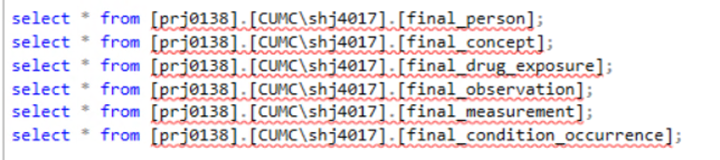
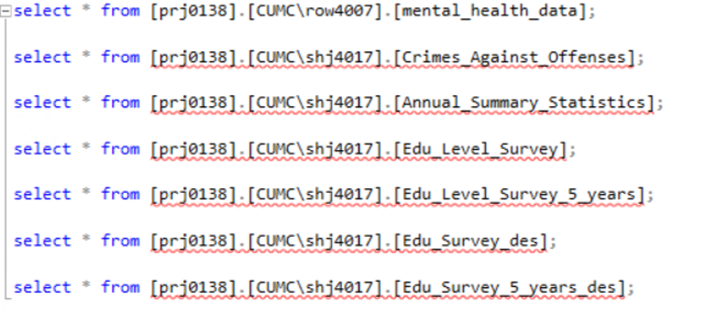
Database Explanation
In order to construct an EHR database (fake data) that conforms to the OMOP model, we used code to generate 3,000 randomized data for these tables to simulate the healthcare environment of a location to begin our study. These data are stored in the Data Core and can be queried with the following commands.
In addition to this, our external structural data comes primarily from four official public databases, including education data provided by the U.S. Census Bureau (U.S. Census Bureau), crime statistical trends from the FBI (Crime Data Explorer), county-level health assessments (County Health Rankings & Roadmaps), and macroeconomic data from the U.S. Bureau of Economic Analysis (BEA). These data provide important support for our analysis of the impact of state-level social structural factors on mental health. These data are also stored in Data Core after we have structured them to be queried with the following commands.

Slide 8
Database Explanation
final_person(person_id, gender_concept_id, year_of_birth, month_of_birth, day_of_birth, race_concept_id, ethnicity_concept_id, state, marital_status_concept_id, education_level_concept_id, income_level_concept_id, insurance_type)
final_drug_exposure(drug_exposure_id, person_id, drug_concept_id, drug_exposure_start_date, drug_exposure_end_date, drug_type_concept_id, dose_quantity, dose_unit_concept_id, route_concept_id, frequency, source_value)
final_condition_occurrence(condition_occurrence_id, person_id, condition_concept_id, condition_start_date, condition_end_date, condition_type_concept_id, provider_id, visit_occurrence_id, condition_status_concept_id, source_value)
final_observation(observation_id, person_id, observation_concept_id, observation_date, observation_time, value_as_concept_id, value_as_string, observation_type_concept_id, source_value, visit_occurrence_id)
final_measurement(measurement_id, person_id, measurement_concept_id, measurement_date, measurement_time, value_as_number, unit_concept_id, measurement_type_concept_id, source_value, visit_occurrence_id)
final_concept(concept_id, concept_name, domain_id, vocabulary_id, concept_class_id, standard_concept, concept_code, valid_start_date, valid_end_date, invalid_reason)
Edu_Survey_des(Column_Name, Label)
Edu_Survey_5_years_des(Column_Name, Label)
mental_health_data(FIPS, Year, State, Count_Poor_Mental_Days, gPct_Low, gPct_CI_Low, gPct_CI_High, gPct_StdErr, Age_Adj_Low, Age_Adj_High, …, pct_Low_Income, pct_Rural)
Annual_Summary_Statistics(GeoFips, GeoName, LineCode, Category, Description, 1998, 1999, 2000, 2001, 2002, ..., 2024)
Crimes_Against_Offenses(State, Number_of_Participating_Agencies, Population_Covered, Total_Person_Offenses, Assault_Offenses, Homicide_Offenses, Human_Trafficking, Kidnapping_Abduction, Sex_Offenses, Year, Total_Property_Offenses, Arson, Bribery, Burglary_Breaking_and_Entering, Counterfeiting_Forgery, Destruction_Damage_Vandalism, Embezzlement, Extortion_Blackmail, Fraud_Offenses, Larceny_Theft_Offenses, Motor_Vehicle_Theft, Robbery, Stolen_Property_Offenses, Total_Society_Offenses, Animal_Cruelty, Drug_Narcotic_Offenses, Gambling_Offenses, Pornography_Obscene_Material, Prostitution_Offenses, Weapon_Law_Violations)
Edu_Level_Survey(GEO_ID, NAME, S1501_C01_001E, S1501_C01_001M, S1501_C01_002E, S1501_C01_002M, ..., S1501_C06_064E, S1501_C06_064M, Year)
Edu_Level_Survey_5_years(GEO_ID, NAME, S1501_C01_001E, S1501_C01_001M, S1501_C01_002E, S1501_C01_002M, ..., S1501_C06_064E, S1501_C06_064M, Year)

Slide 9
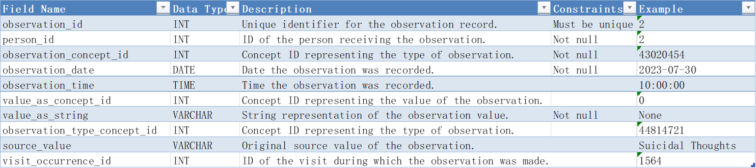
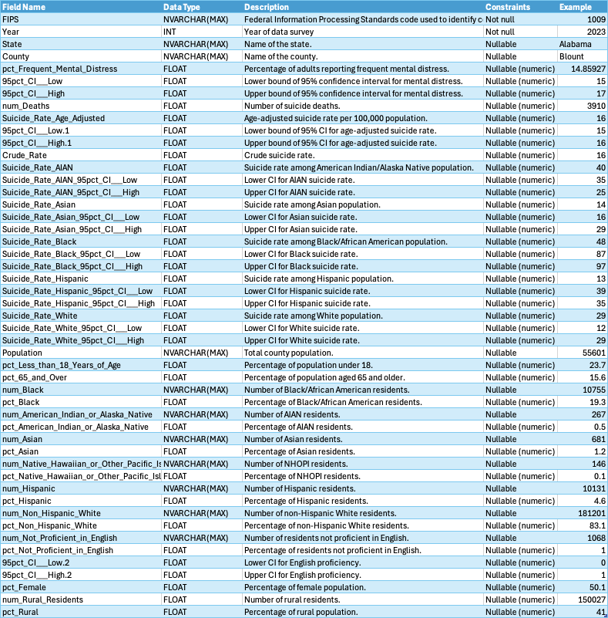
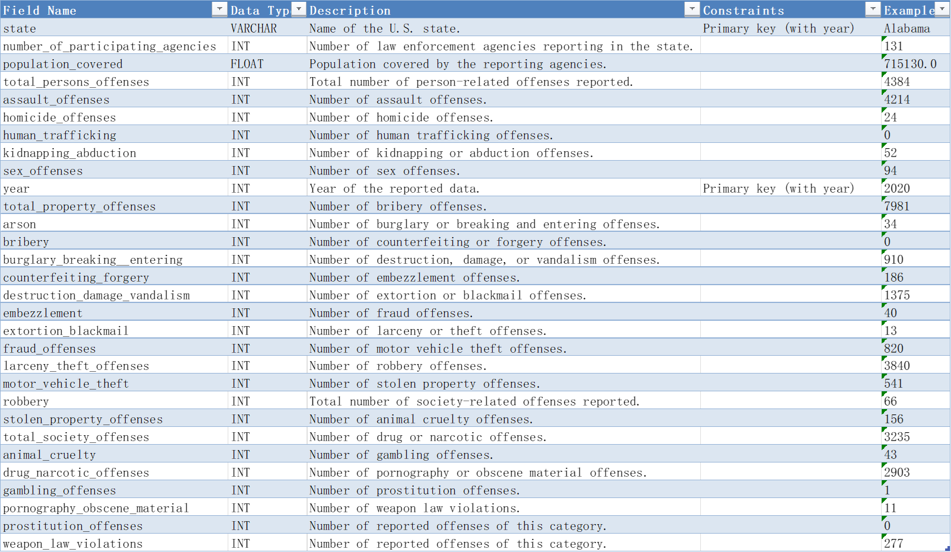
Database Explanation
More dictionaries showing in REPORT

Slide 10
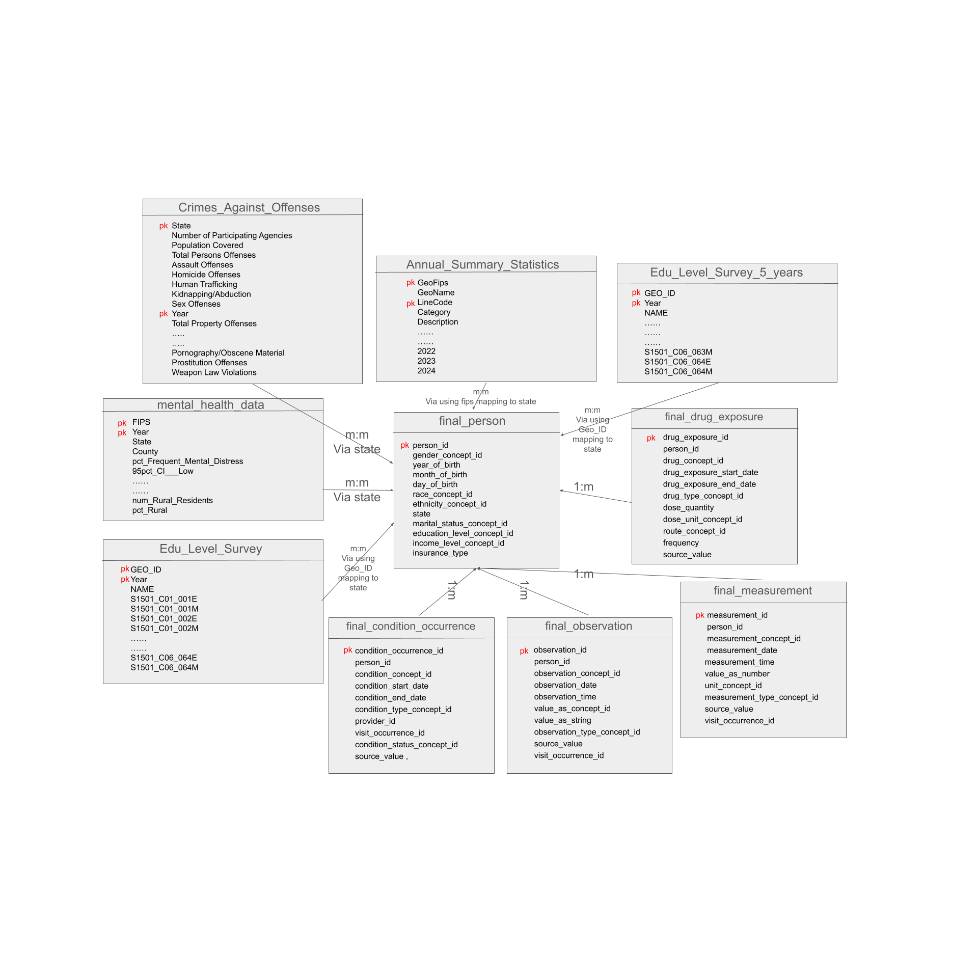
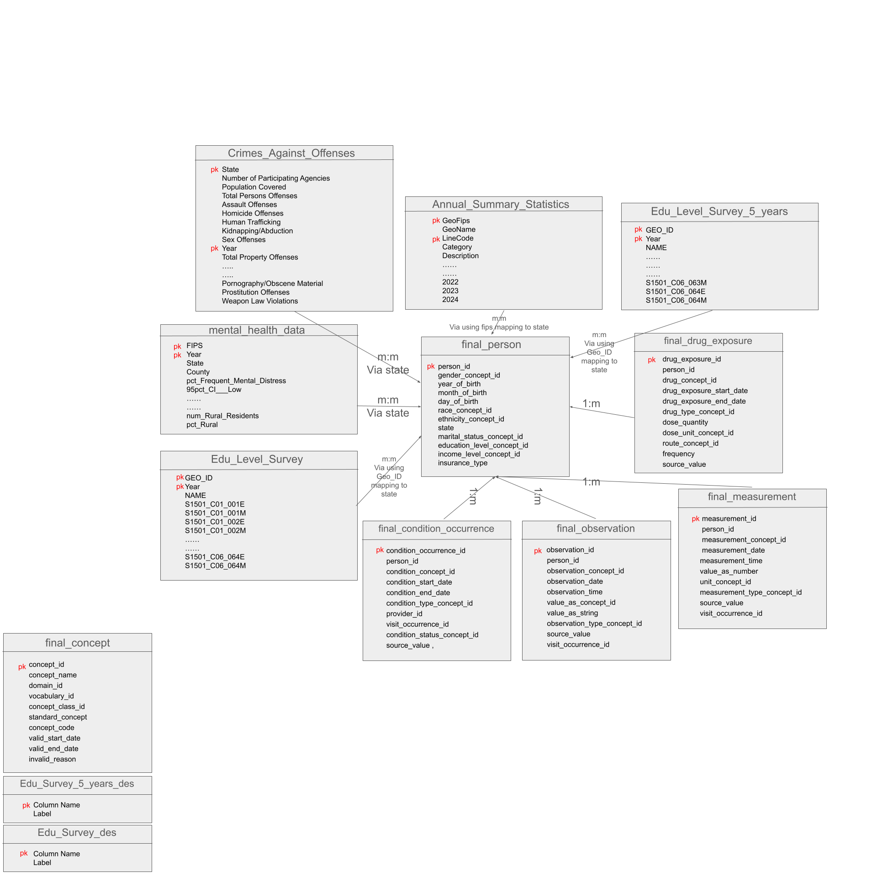
Database Explanation
The final_concept table provides standardized definitions for all medical-related concept IDs (e.g., diagnoses, drug exposures, observations), serving as a central reference in the OMOP data model.
The Edu_Survey_des and Edu_Survey_5_years_des tables contain descriptive labels for the educational survey variables, helping to interpret the column names in the corresponding survey data tables (e.g., Edu_Level_Survey).

Slide 11
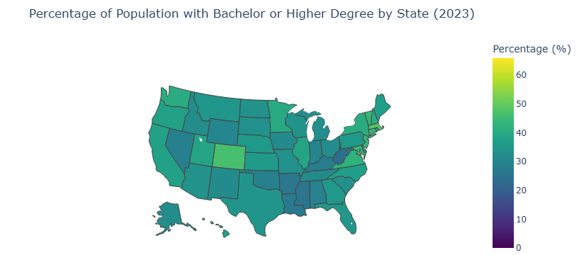
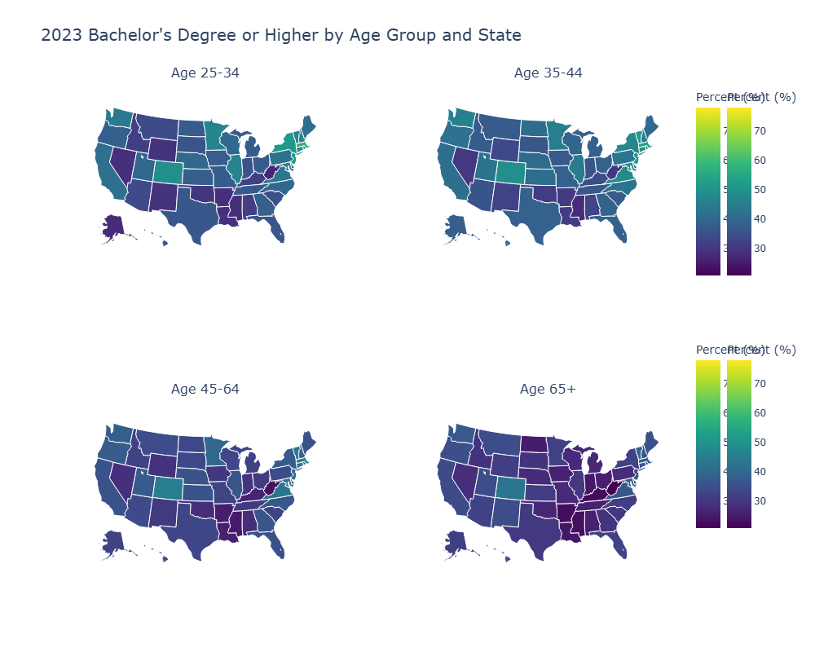
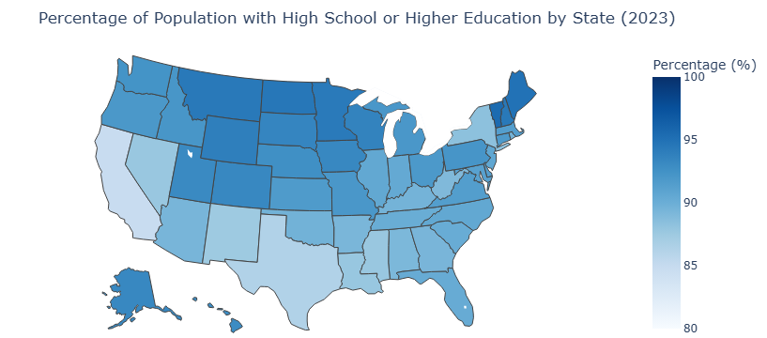
Education

Slide 12
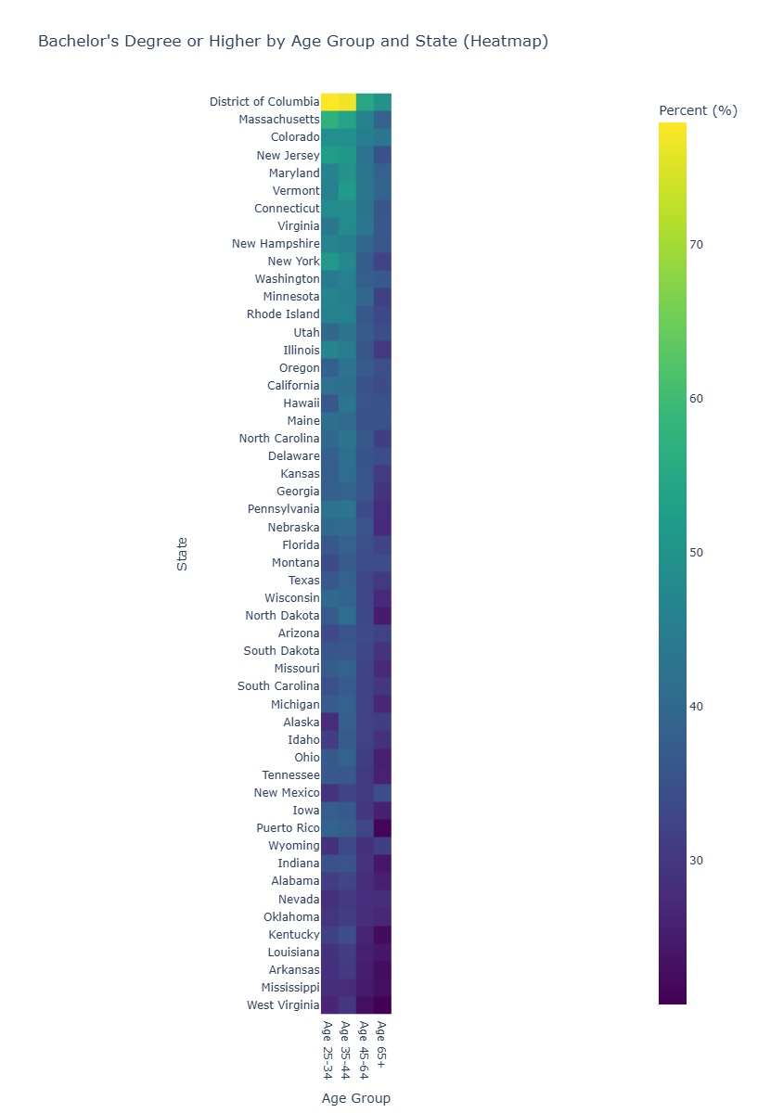
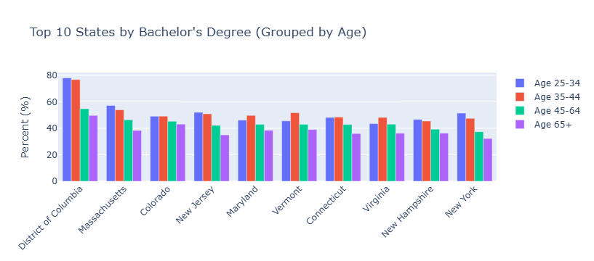
Education

Slide 13
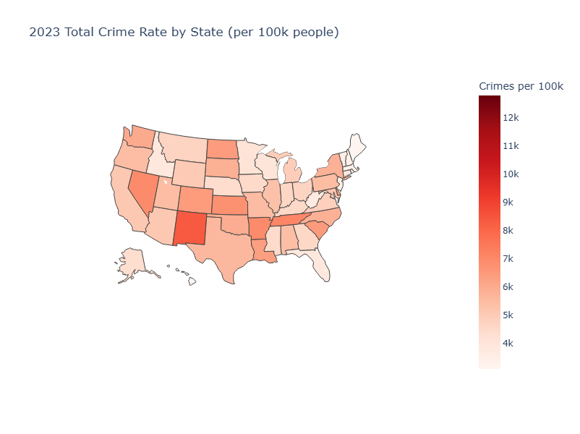
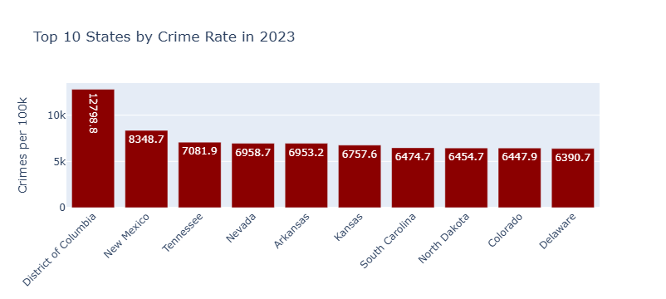
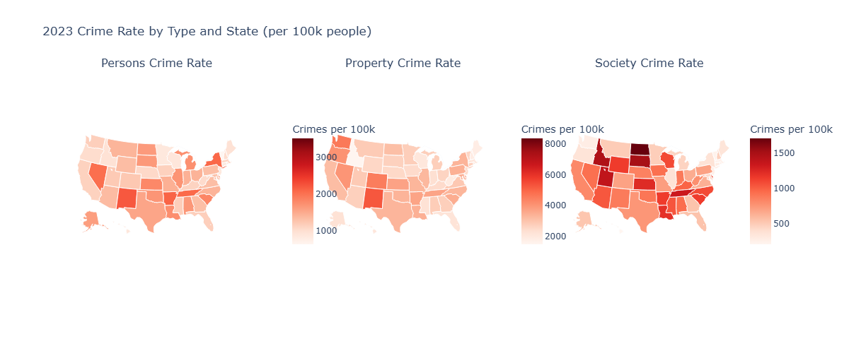
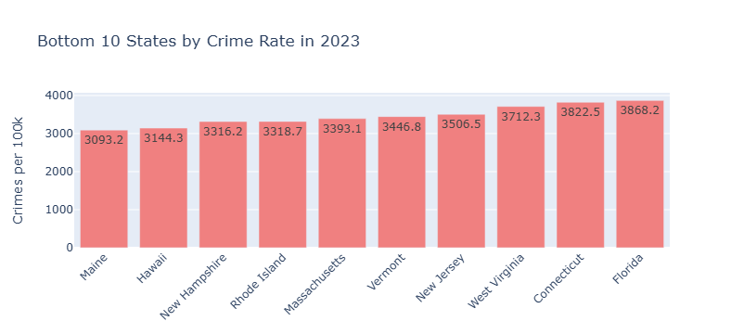
Crime

Slide 14
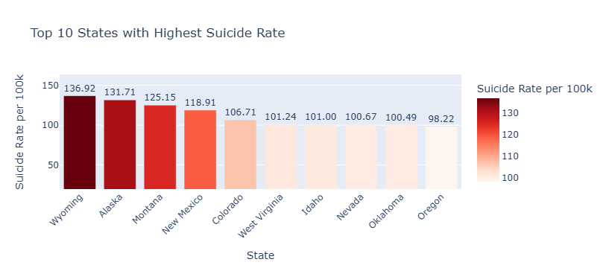
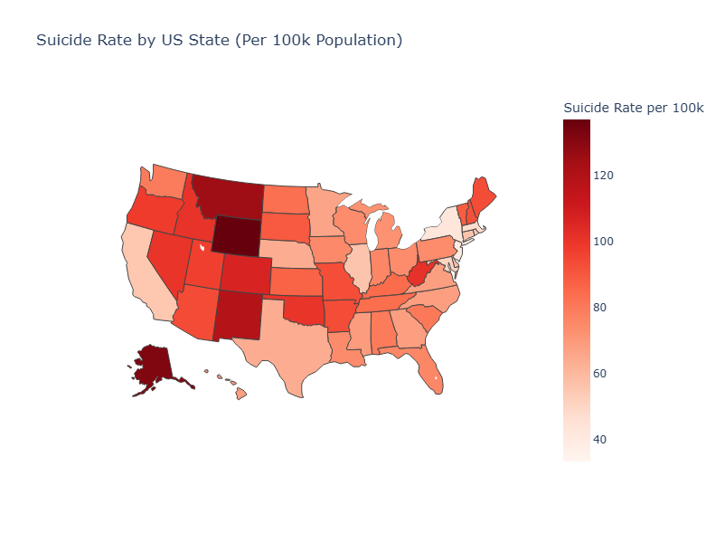
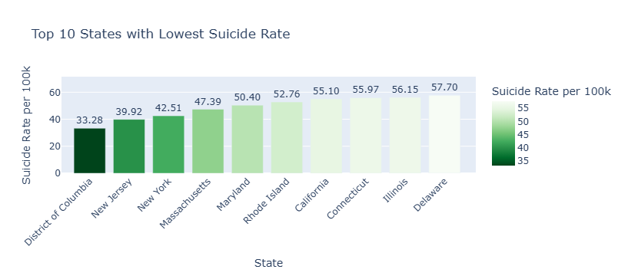
Suicide

Slide 15
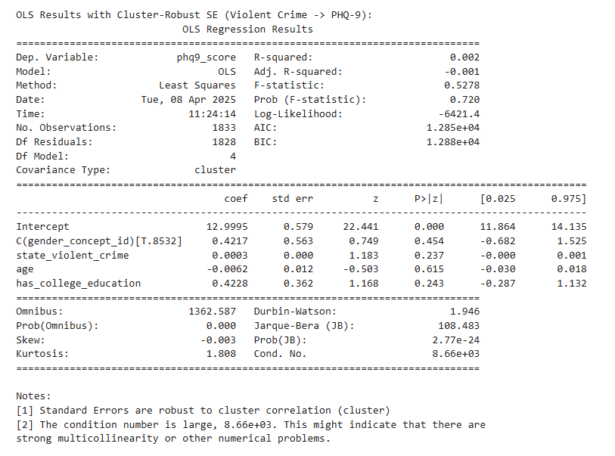
Hypothese 1
Notes:
"Moving on to our first hypothesis, we investigated whether regional safety, measured by crime rates, is negatively associated with mental health outcomes, specifically higher PHQ-9 scores indicating poorer mental health."
"This slide shows the results from an OLS regression model predicting individual PHQ-9 scores based on the state-level violent crime rate, while controlling for individual age, gender, and whether the individual has a college education. Importantly, we used cluster-robust standard errors, grouping by state, to account for individuals living within the same state."
"Looking at the coefficient for state_violent_crime (which is 0.0003), we see a very small positive value. More critically, the p-value is 0.237, which is well above the conventional significance threshold of 0.05."
"This means we did not find a statistically significant association between the violent crime rate in a state and the PHQ-9 scores of individuals residing there, after accounting for individual factors."

Slide 16
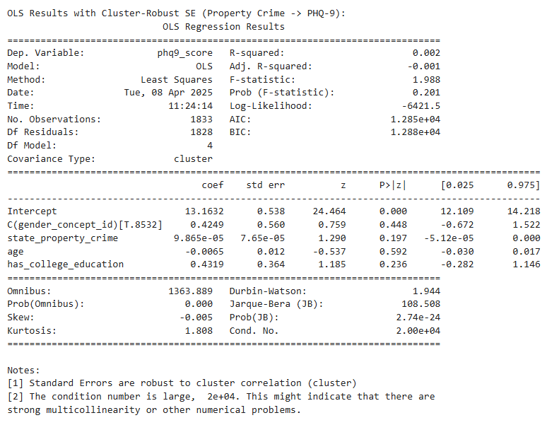
Hypothese 1
Notes:
"We also tested Hypothesis 1 using the state-level property crime rate as the measure of regional safety. This slide presents the results from a similar OLS regression model, again controlling for age, gender, and individual education, and using cluster-robust standard errors."
"Here, the coefficient for state_property_crime is approximately 0.0001, which is again very small. The associated p-value is 0.197, also not statistically significant."
"Similar to violent crime, we found no significant association between state-level property crime rates and individual PHQ-9 scores."
"Based on these regression analyses using data from 1833 individuals across 8 states, our results do not support Hypothesis 1. We did not find evidence that higher state-level crime rates are significantly associated with poorer individual mental health as measured by PHQ-9 scores in this sample."

Slide 17
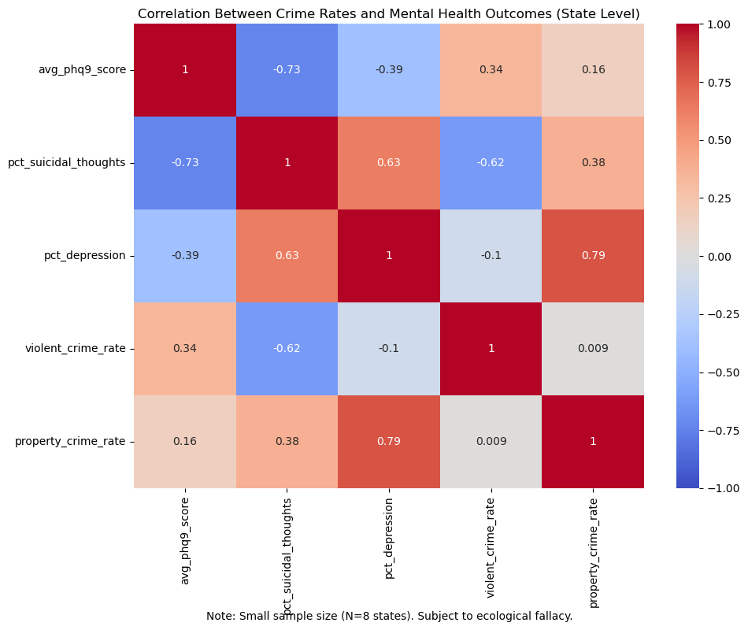
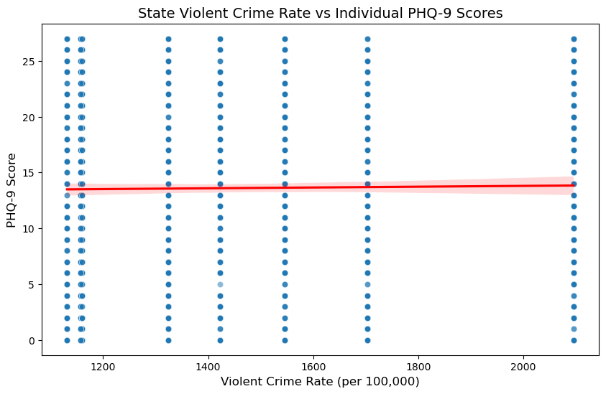
Hypothese 1
Notes:
"To further explore the relationship between crime and mental health, this slide presents two visualizations."
"On the left, we see a correlation heatmap based on state-level averages. The correlations between average PHQ-9 scores and both violent crime (r=0.339) and property crime (r=0.158) are weak and positive. However, it's crucial to note this analysis is based on only 8 states and is subject to ecological fallacy – we cannot infer individual-level relationships from these aggregate correlations."
"On the right, we have a scatter plot showing individual PHQ-9 scores against the state-level violent crime rate for all 1833 participants. Each dot is an individual. We can see a wide spread of PHQ-9 scores across different crime rates. The red line represents the overall trend from the OLS regression we just discussed. Its nearly flat slope visually confirms the lack of a significant relationship between state violent crime and individual PHQ-9 scores."
"Both the aggregate correlations and the individual-level scatter plot are consistent with our regression findings – no strong evidence linking higher crime rates to significantly worse mental health outcomes in this dataset."

Slide 18
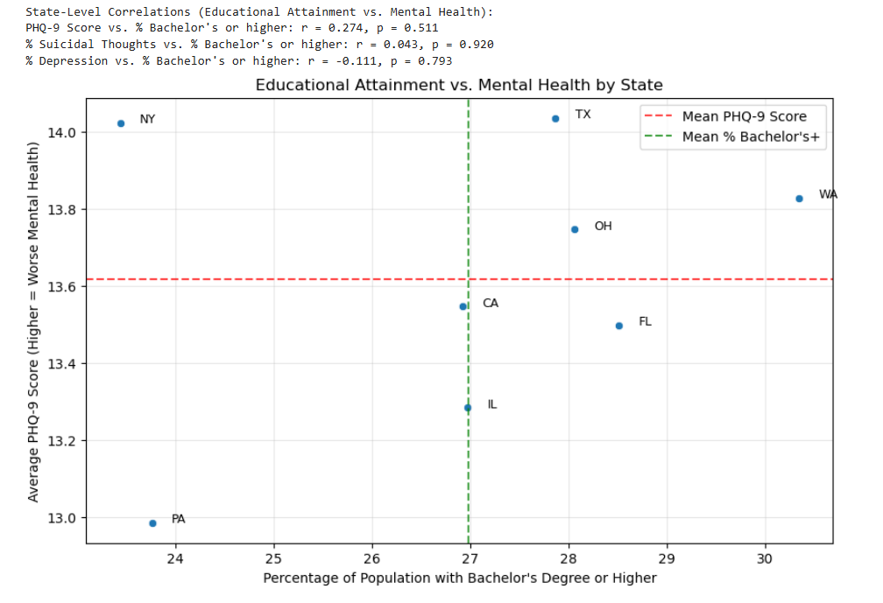
Hypothese 2
Notes:
"Now, let's turn to Hypothesis 2, which proposes that higher educational attainment in a region is positively associated with better mental health outcomes for residents."
"This scatter plot shows the relationship at the state level. We've plotted the average PHQ-9 score for each of the 8 states against the percentage of the population aged 25 and older with a Bachelor's degree or higher in that state."
"The Pearson correlation coefficient is r = 0.274, with a p-value of 0.511. This indicates a weak positive correlation, which is not statistically significant."
"At the aggregate state level, we do not see evidence supporting Hypothesis 2. If anything, there's a slight trend in the opposite direction."
"Again, this is an ecological correlation based on only 8 states and should be interpreted cautiously. Let's examine the individual-level data using regression."

Slide 19
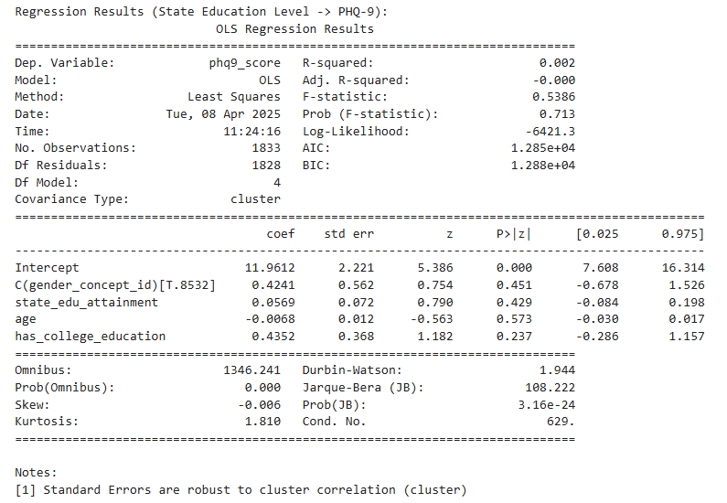
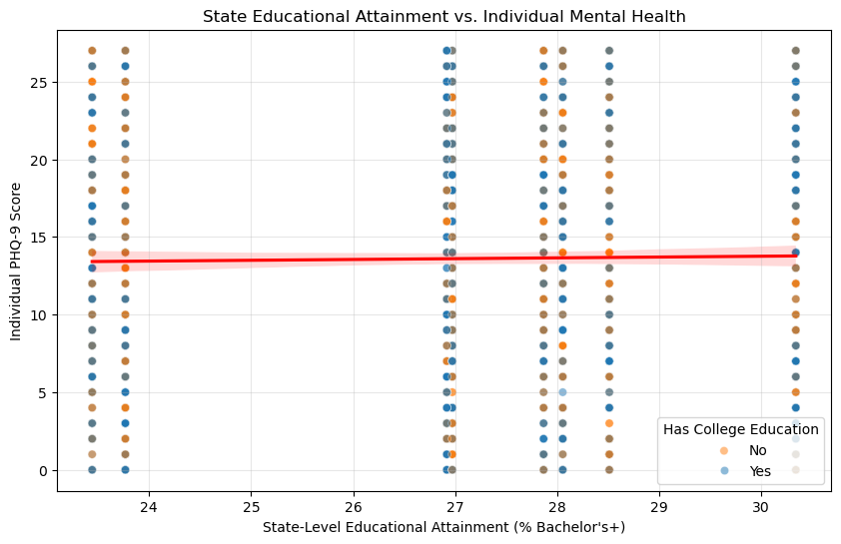
Hypothese 2
Notes:
"This slide shows the results of our first individual-level regression model for Hypothesis 2. We are predicting individual PHQ-9 scores using both state-level educational attainment and individual-level college education, while controlling for age and gender, and using cluster-robust standard errors."
"Looking at the main effects:
The coefficient and p-value for state_edu_attainment and has_college_education are not significant.
"In this model looking only at main effects, neither the average education level of the state nor an individual's own college education status shows a statistically significant association with their PHQ-9 score."
"This initial regression model does not provide support for Hypothesis 2, either at the state or individual level as main effects."

Slide 20
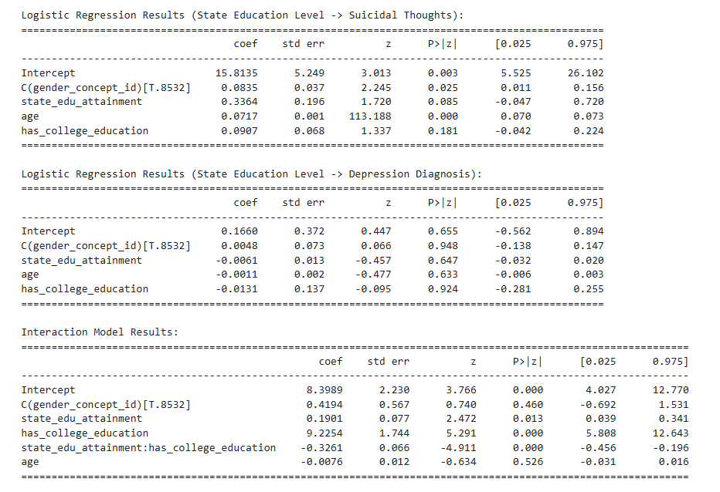
Hypothese 2
Notes:
"Since the relationship might be more complex, we tested for an interaction effect. Does the association between state-level education and mental health differ depending on an individual's own education level? This slide shows the results."
"We added an interaction term: state_edu_attainment multiply has_college_education. The key finding here is the coefficient for this interaction term, which is -0.3261 and is highly statistically significant (p < 0.001)."
"This significant negative interaction tells us that the relationship between state-level education and PHQ-9 scores is different for those with and without college education."
"In other words, higher state-level education appears to be associated with better mental health primarily for those who are themselves college-educated, while potentially being associated with slightly worse mental health for those without a college education in this sample."
"Hypothesis 2 is not supported in a simple sense, but this interaction reveals a crucial difference. Higher regional educational attainment is associated with better mental health, but this benefit seems primarily concentrated among individuals who also have higher personal education."

Slide 21
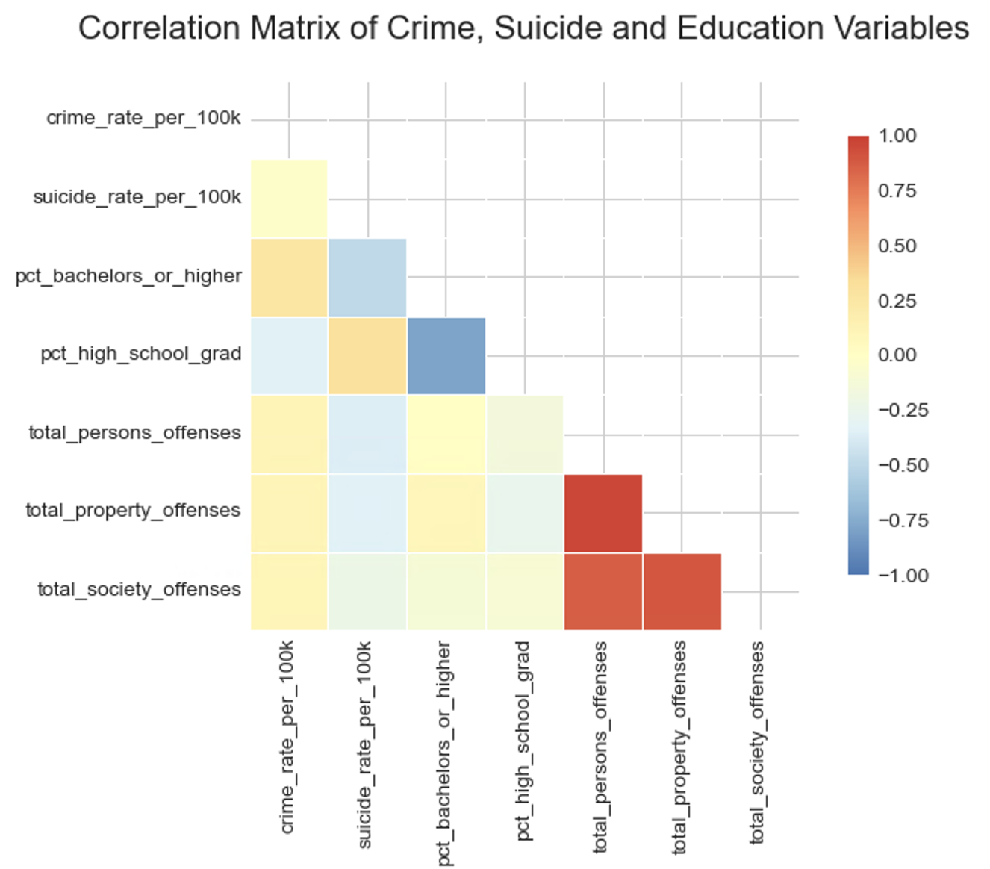
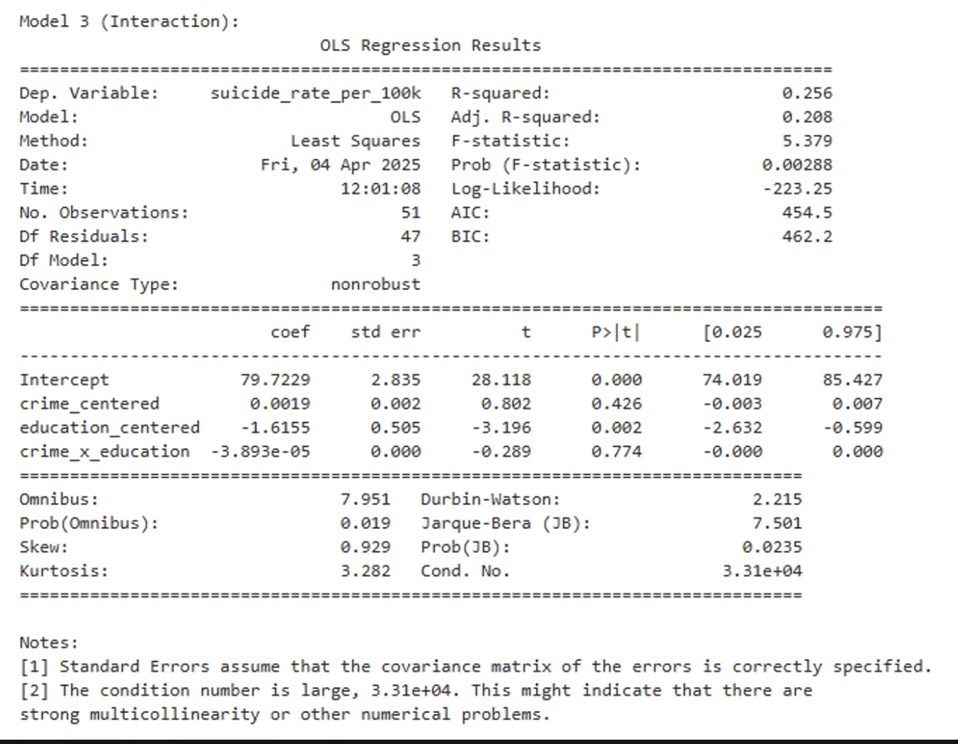
Hypothese 3 - Linear Analysis
suicide_rate_per_100k = β0 + β1 * crime_centered + β2 * education_centered + β3 * crime × education + error

Slide 22
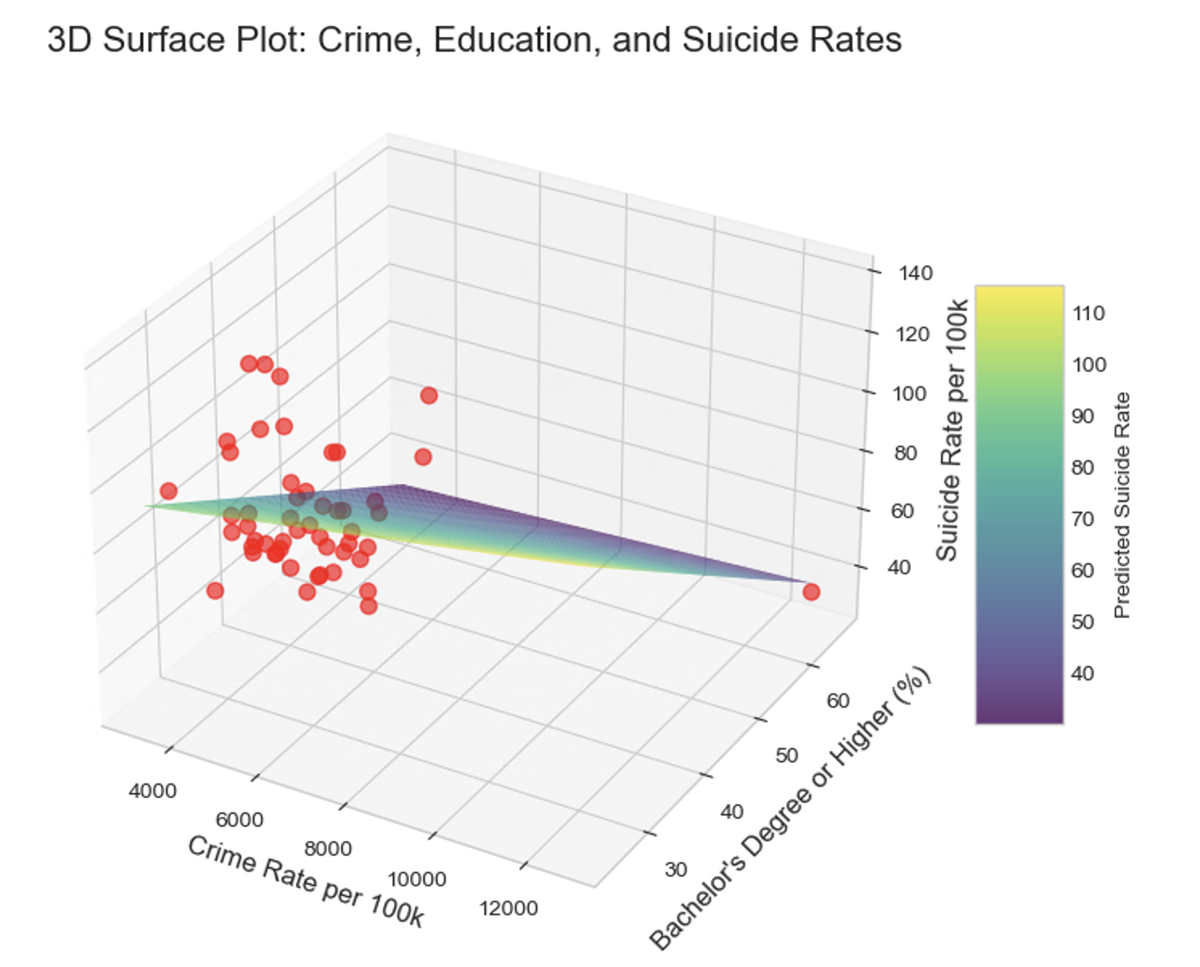
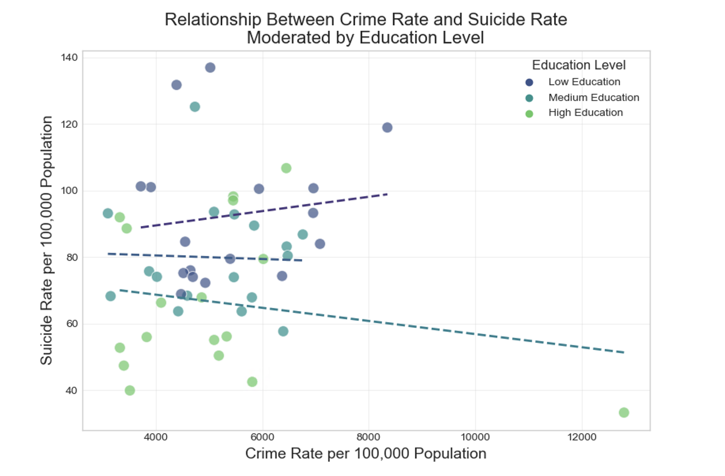
Hypothese 3

Slide 23
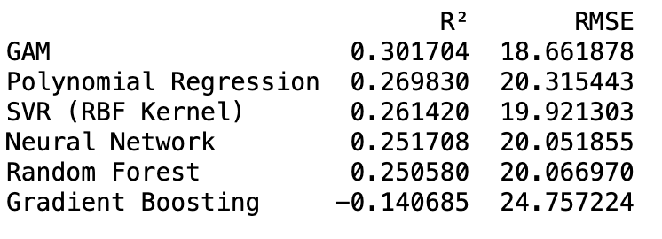
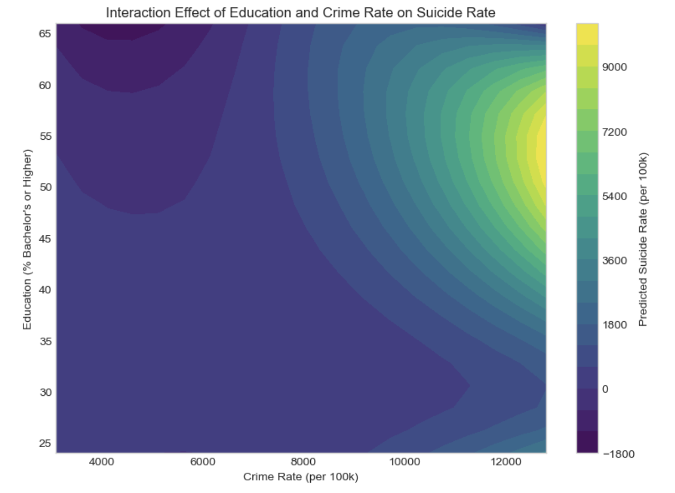
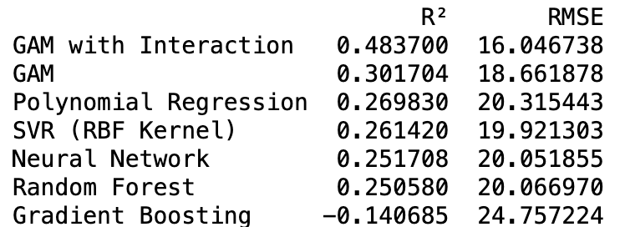
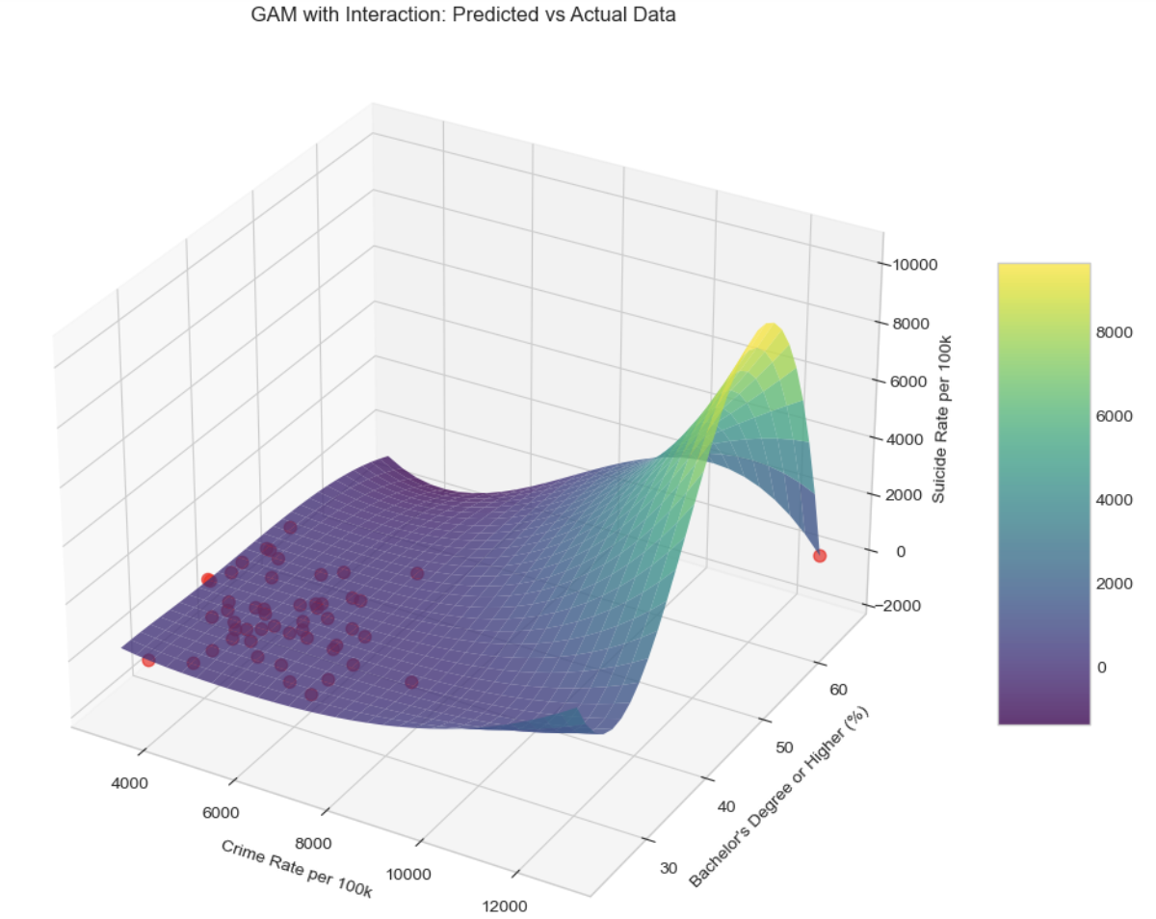
Hypothese 3 - Non-linear analysis
interaction_formula = """suicide_rate_per_100k ~
bs(crime_rate_per_100k, df=4) +
bs(pct_bachelors_or_higher, df=4) +
bs(crime_rate_per_100k, df=3):bs(pct_bachelors_or_higher, df=3)"""

Slide 24
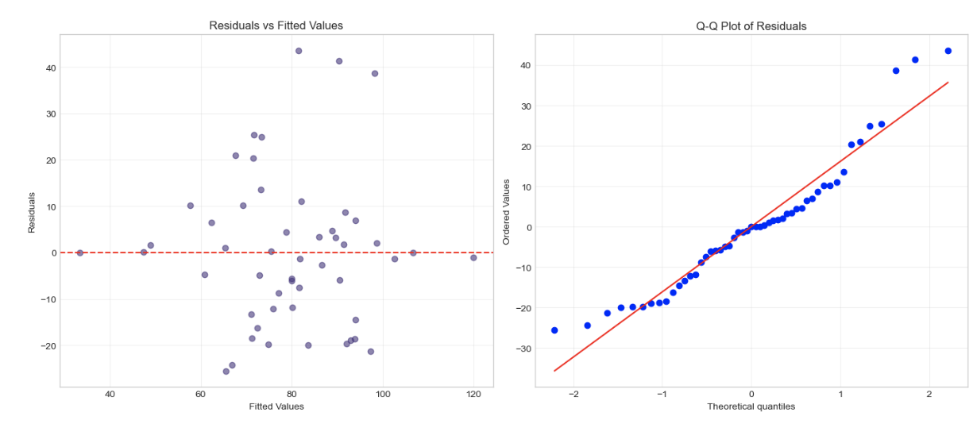
Hypothese 3 - Non-linear analysis

Slide 25
Conclusion
Limitations
Limited Variables The model only includes crime and education — other important factors like income, healthcare access, unemployment, and social support were not considered.
Cross-Sectional Data Results show associations, not causality — we can’t tell which came first.
Further Research Directions
Add More Variables Include other known mental health predictors: income inequality, access to healthcare, unemployment, etc.
Test Causal Relationships Use longitudinal data or quasi-experimental designs to assess causality.
Explore Subgroups Analyze effects separately by age, gender, race, or rural vs. urban areas.

Slide 26
Reference
Panchal, N., Saunders, H., Rudowitz, R., & Cox, C. (2023, March 20). The implications of COVID-19 for mental health and substance use. KFF. https://www.kff.org/coronavirus-covid-19/issue-brief/the-implications-of-covid-19-for-mental-health-and-substance-use/
Dennison CR, Swisher RR. Postsecondary Education, Neighborhood Disadvantage, and Crime: An Examination of Life Course Relative Deprivation. Crime Delinq. 2019 Feb;65(2):215-238. doi: 10.1177/0011128717753115. Epub 2018 Jan 13. PMID: 31007271; PMCID: PMC6469862.
Pak, S., & Choung, W. J. (2020). Relative deprivation and suicide risk in South Korea. Social Science & Medicine, 247, 112815. https://doi.org/10.1016/j.socscimed.2020.112815
Schieman, S., & Pearlin, L. I. (2006). Neighborhood Disadvantage, Social Comparisons, and the Subjective Assessment of Ambient Problems Among Older Adults. Social Psychology Quarterly, 69(3), 253-269. https://doi.org/10.1177/019027250606900303 (Original work published 2006)
County Health Rankings & Roadmaps. University of Wisconsin Population Health Institute. (2024). County Health Rankings & Roadmaps. https://www.countyhealthrankings.org/
U.S. Census Bureau - Education Table. U.S. Census Bureau. (2024). Education data tables. https://data.census.gov/table?q=Education&g=010XX00US$0400000
FBI Crime Data Explorer (Crime Trends). Federal Bureau of Investigation. (2024). Crime Data Explorer: Crime trends. https://cde.ucr.cjis.gov/LATEST/webapp/#/pages/explorer/crime/crime-trend
Bureau of Economic Analysis (BEA). U.S. Bureau of Economic Analysis. (2024). Official website. https://www.bea.gov/

Slide 27
Thank you

